Slide 1

Global Salary Survey Analysis
BY SRI HARIHARAN CR
BATCH DADS JUNE
Millstone 2

Slide 2

Introduction
The aim of this Project is to analyze salary data to understand how different factors like Job title, country, gender, education level, and years of experience affect a person’s salary
The goal is to find patterns and insights that can help explain salary differences and trends.

Slide 3


Dataset Overview
The dataset used in this project is a salary survey collected from employees in various countries and industries. It contains details like
• Job Title
• Country
• Gender
• Education Level
• Years of Experience
• Annual Salary
• Additional Compensation

Slide 4


Data Preprocessing
Data Cleaning was done in Excel
Removing Unwanted Rows and columns missing or incorrect data Formatting columns Properly standardizing text values
After cleaning, the data was saved as a CSV file for Further Use.

Slide 5

Data Analysis - MySQL
The Cleaned Dataset was Imported into MySQL. A Database and table were created, and the data was uploaded. Several SQL queries were written to explore insights, including

Slide 6



Average Salary by Industry and Gender
Total Compensation by Job Title Salary Distribution by Education
Level
Number of Employees by Industry and Experience
Median Salary by Age Range and Gender
Highest Paying Job Title in Each Country
Average Salary by City and Industry
Percentage of Employees Receiving Additional Compensation by
Gender
Total Compensation by Job Title and Experience
Average Salary by Industry, Gender, and Education Level
Each query result was exported as a separate CSV file for use in Tableau

Slide 7
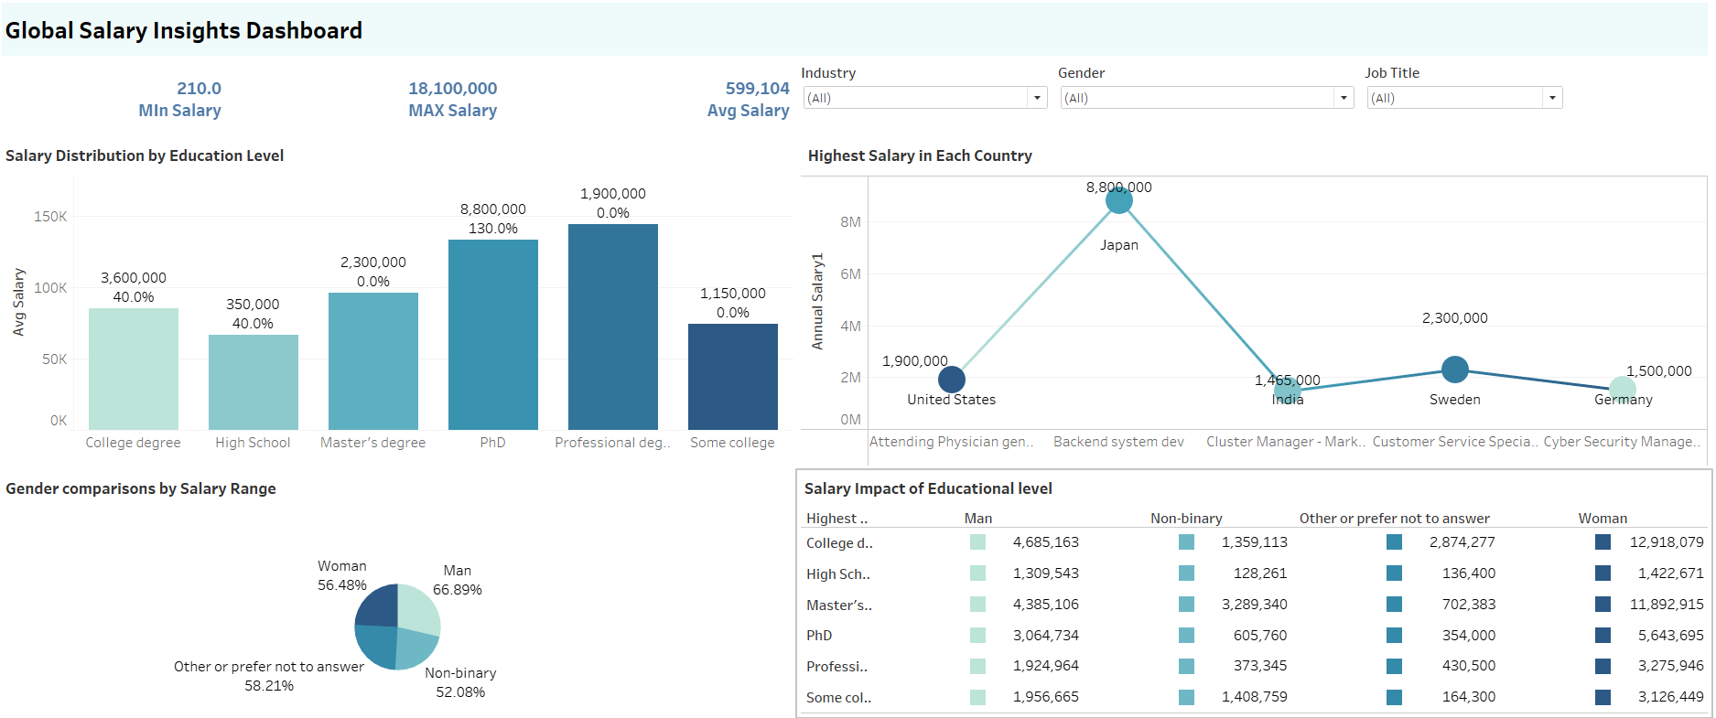
Dashboard Overview

Slide 8
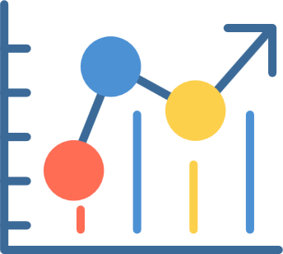
Insights
Education Matters
Higher degrees = higher pay
PhDs get the best salaries and extra perks
Recommendations
Support higher education
Fix gender pay gaps
Include non-binary & diverse groups
Work abroad for better pay
Top Paying Jobs & Countries
Japan: Backend Developer
Sweden: Customer Service
USA: Attending Physician
These countries offer the highest salaries
Gender Pay Gap
Men earn more than women for similar jobs
Gap is bigger in tech roles

Slide 9

Conclusion
SQL and Excel helped clean and analyze
large datasets efficiently.
Data-driven insights show how salary
varies by job, country, and personal
factors.
Tableau dashboards provide clear visuals for decision-making.

Slide 10
THANK
YOU

